Slide 1
Bayesian Matting Final Presentation
Matting based on Bayesian algorithm
Lingyu Gong, Changhong Li, Qiwen Tan
E3 School
Date 21/03/2024

Slide 2
Bayesian Matting Final Presentation
Group Overview.
CONTENTS
Performance Measurement.
Implementation highlights.
Optimization functions.
Test Modules.
Notes:
a4301326-5846-449a-9451-7c421c3363df.source.5.zh-Hans

Slide 3
Group Overview - Group Roles & Changes
Algorithm Engineer – Tan
- Algorithm Research
- Algorithm Function Encapsulation
- Build and optimize U-Net Model
- Metrics Evaluation
- Algorithm optimization(Matrix Cal, Dynamic Iteration & Threshold)
- Original work
- Extra work
Dataset Preparation …
Performance
Integrated Optimization Guidance
Algorithm Guidance …
Function Encapsulation, Model Training…
Team
Work
Robustness
Cohesiveness
Reliability Engineer – Gong
- Unit Test
- E2E Test
- UI Design and Integration
- Data set Organization
- Progress Control
- Document Control
Integration Engineer – Li
- System Integration, Flow Control
- Code Linting and Review
- Unit Test Frame Build
- Function Encapsulation
- Model Training
- Metrics Evaluation
UI Integration and optimization …
Unit Test Framework …
Flexible roles, Proactive advancement, Mutual assistance

Slide 4
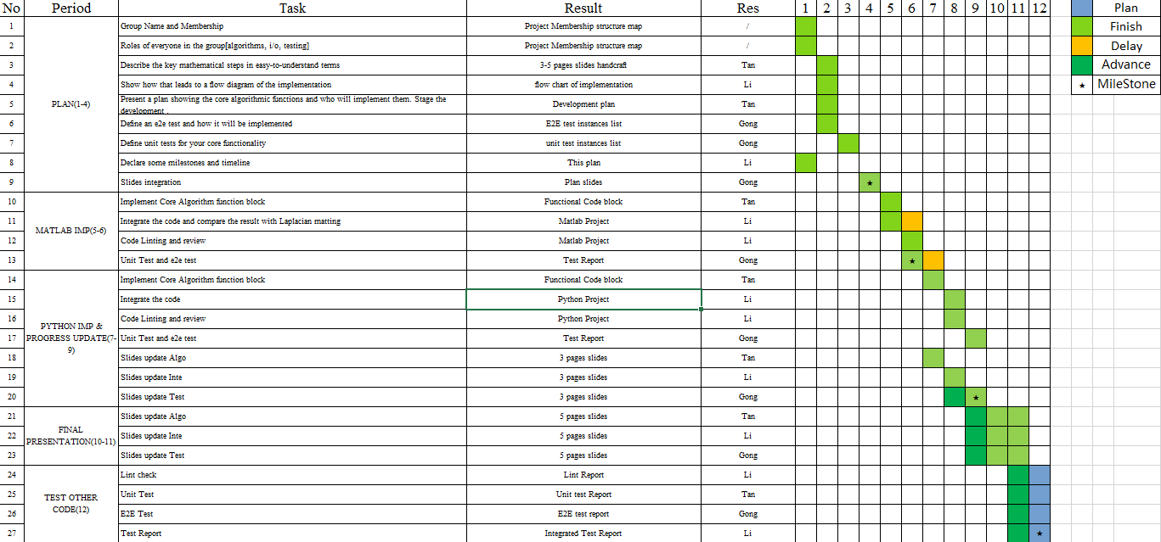
Group Overview - Implementation vs plan
Problem: Task seriality is high
Solution: Redistribute and collaborate to drive progress
Problem: Milestone node requirements in advance
Solution: Re-plan and carry out the next phase of work in advance
Benchmark plans on time, Modify plans in time

Slide 5
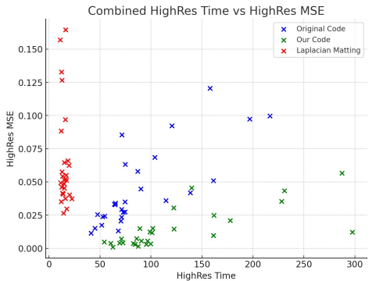

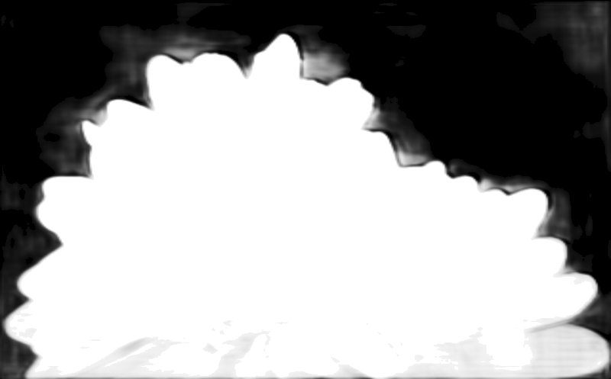
Performance Measurement
Accuracy
Algorithm Comparison (Laplacian vs Ori Bayesian vs Our Bayesian)
MSE(Mean Squared Error): 0.02169
The average squared difference between estimated and ground truth matting results in Bayesian matting
PSNR(Peak Signal-Noise Ratio): 16.63610
The quality of the matting result by comparing the signal power to the noise power.
Laplacian Matting:
Time advantage, not suitable for complex tasks
Original Bayesian Matting:
Relatively balanced
Our Bayesian Matting:
Relatively long time, but the effect is the best
Complexity
Algorithm Comparison (Bayesian + U-Net vs Bayesian + Tri-map)
Elapsed Time: 4.66284 s
Time consumption of Bayesian algorithm in specified operating environment
Memory Usage: 555567 bytes
Memory resource usage of Bayesian algorithm in specified operating environment
Bayesian + U-Net:
Any image input, no need to manually annotate Tri-map
More time consumption(< 2s) and accuracy loss (PSNR = 14.31230)
Bayesian + Tri-map:
Tri-map needed
Less time consumption and accuracy advantage (PSNR = 16.63610)
Tri-map
Tri-map by U-Net
The above performance evaluation is based on GT01 low-resolution images using Ori=8, iteration=2 with python scripts.

Slide 6
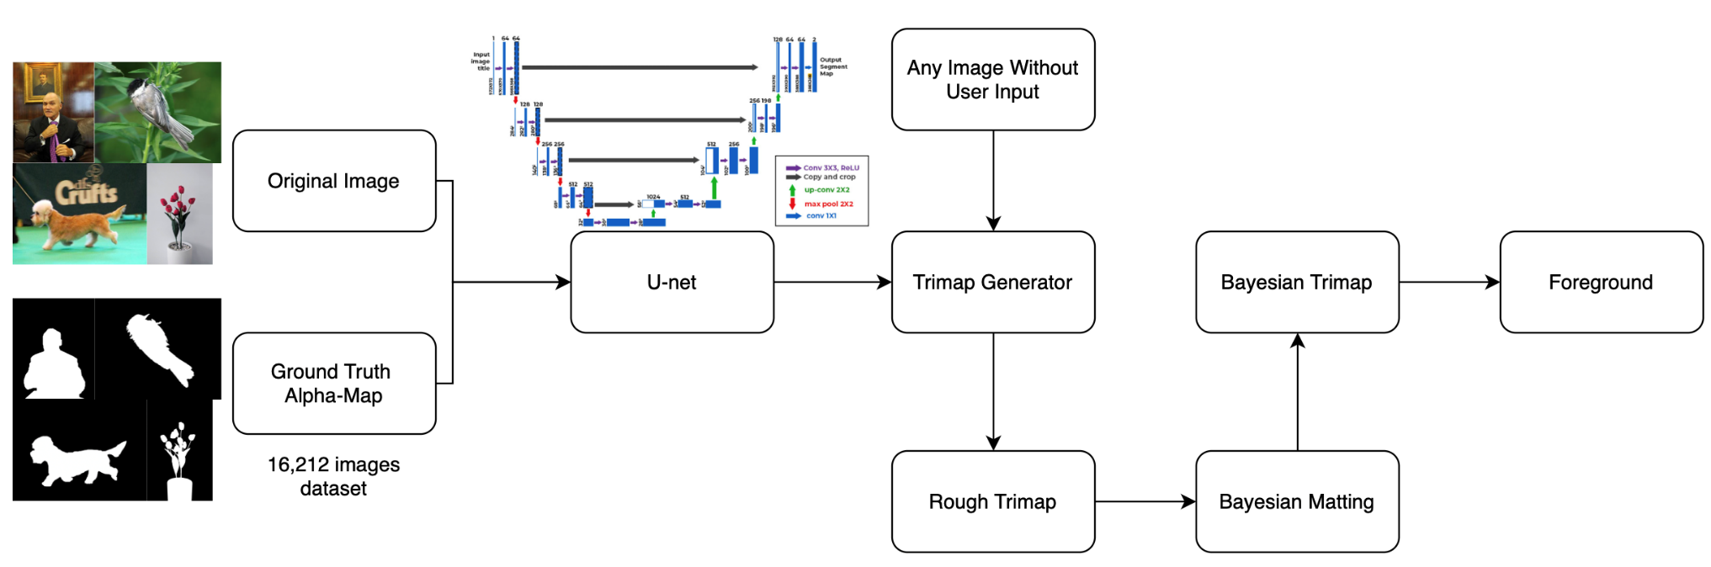
Implementatons
Trimap Generator

Slide 7
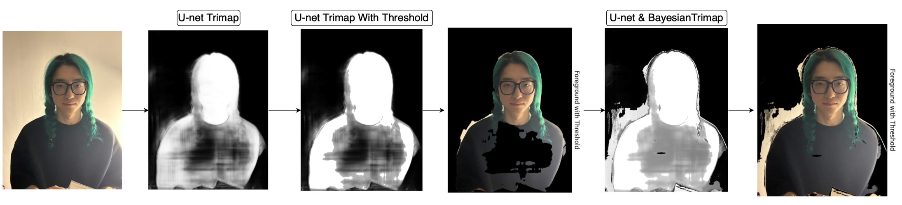
Implementatons
Advantage
No User Inputs Needed & Can Take in Any Size Image

Slide 8
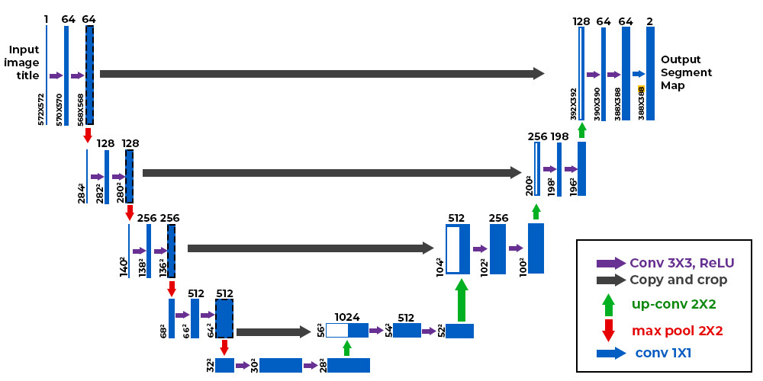
Model
Structure
Loss Function: Dice Loss
Activation Function: ReLU

Slide 9
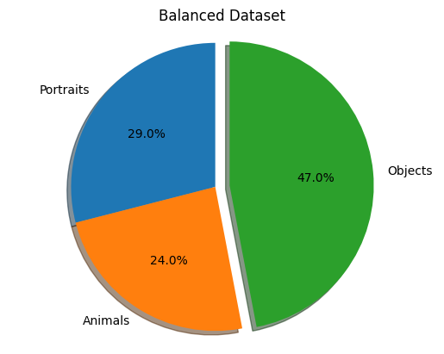
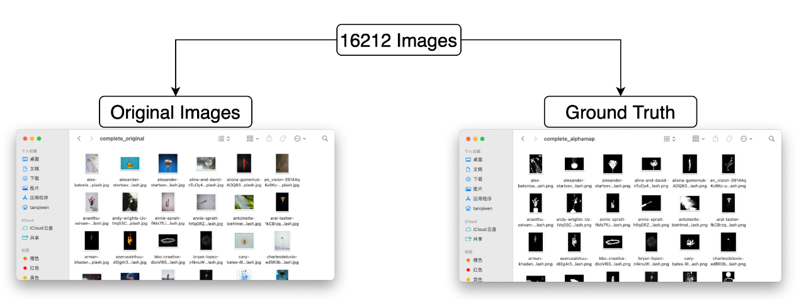
Model
Dataset

Slide 10
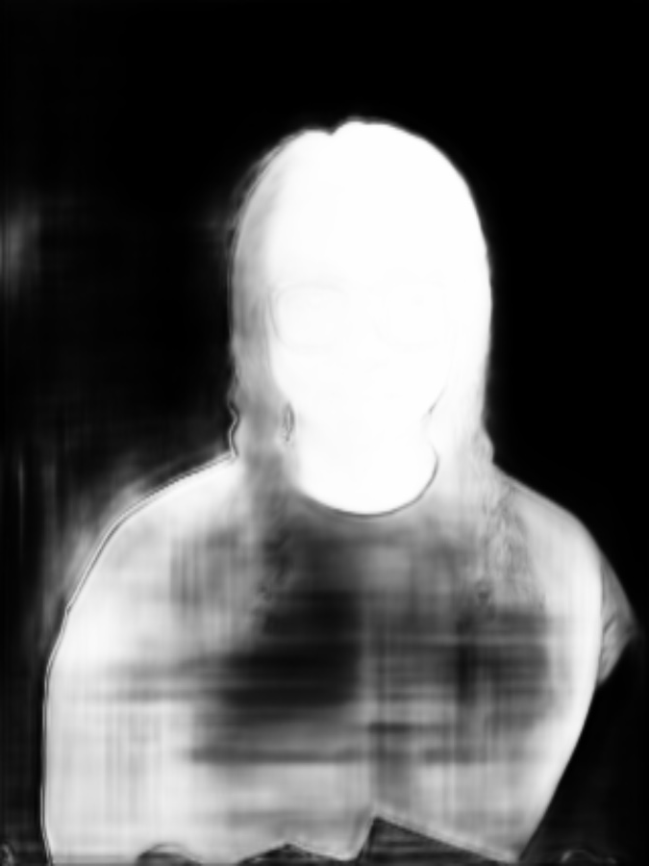
Model
Smooth Alpha-Map
Sigmoid as the activation function for the output layer.
Ensuring the smoothness of the trimap.

Slide 11
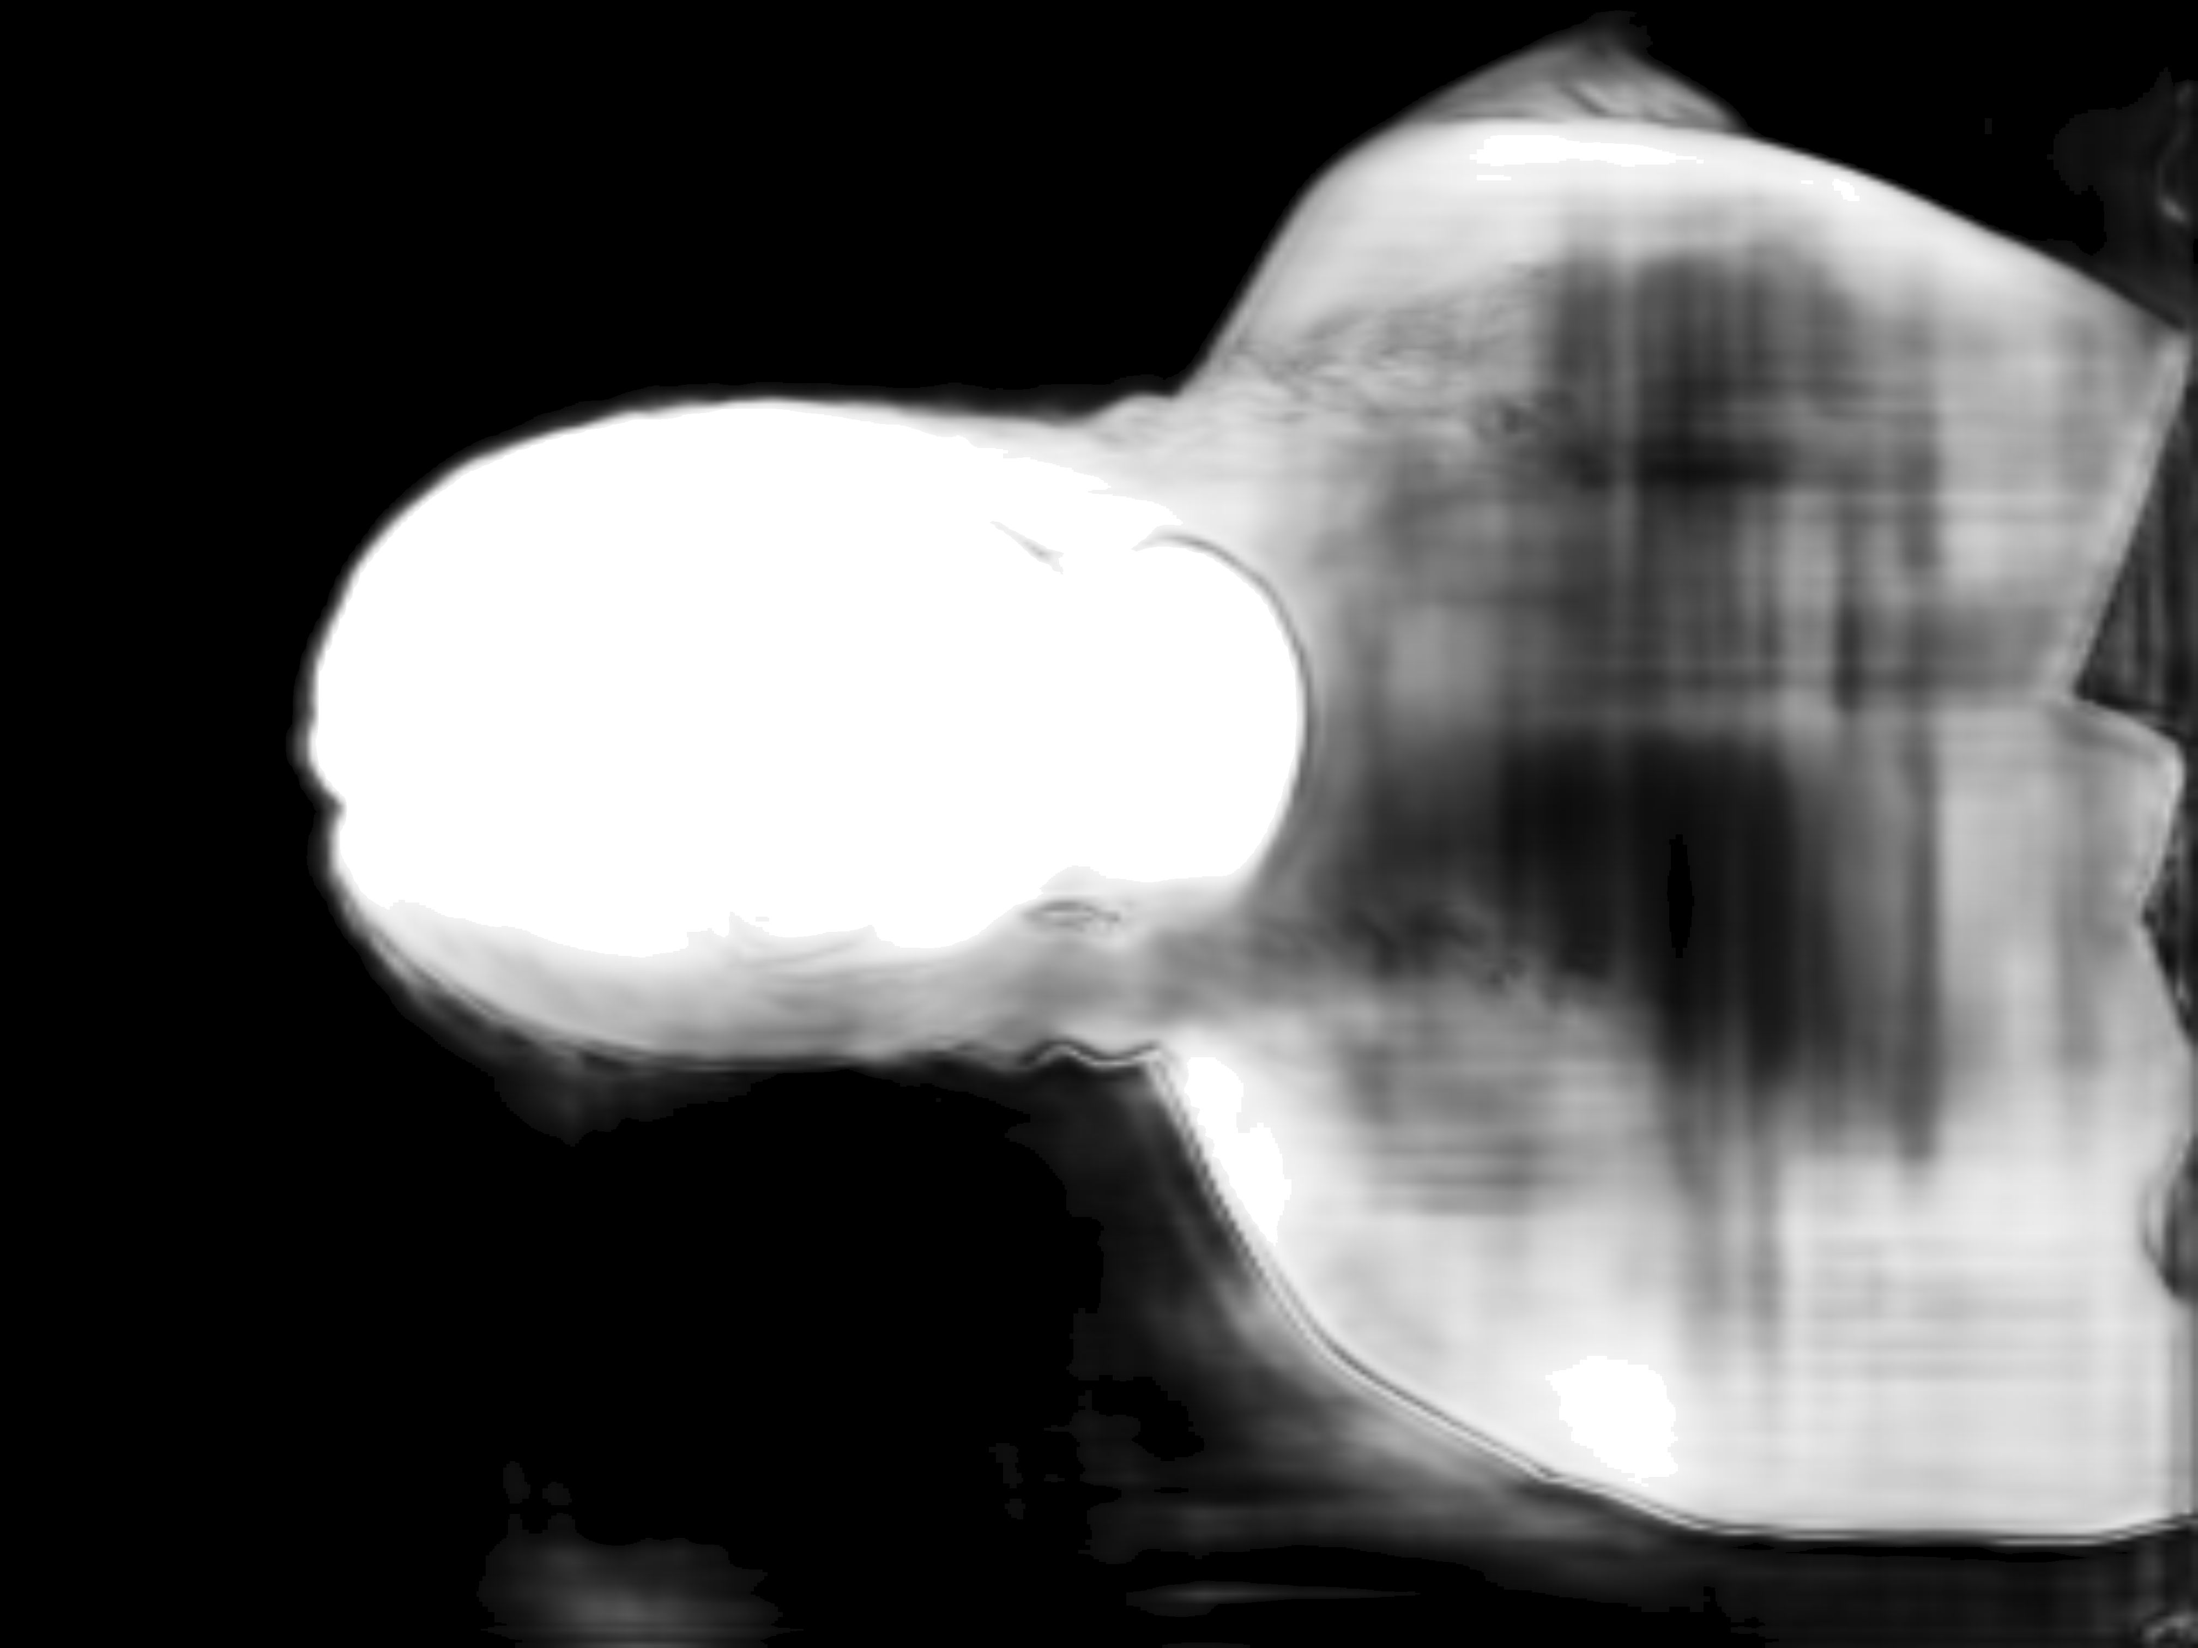

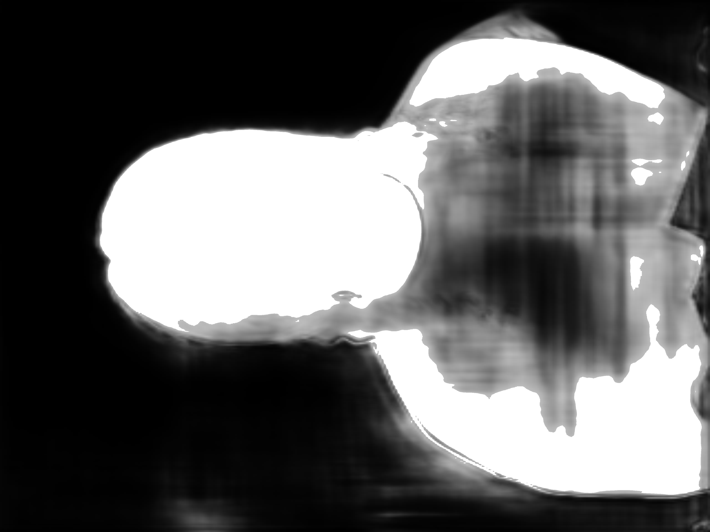
Optimization
Dynamic Foreground / Background Segmentation
Originally
Foreground: >255×0.95
Background: <255×0.05
Optimized
Foreground: 25% whitest pixels
Background: 25% darkest pixels

Slide 12
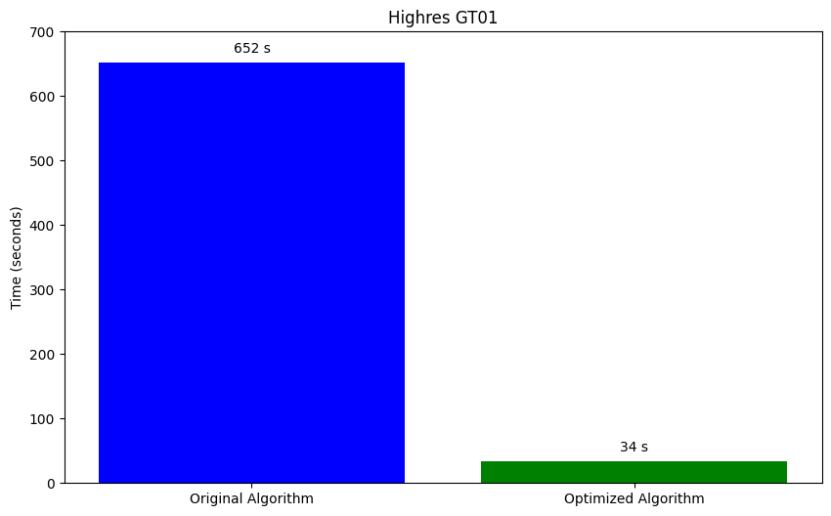
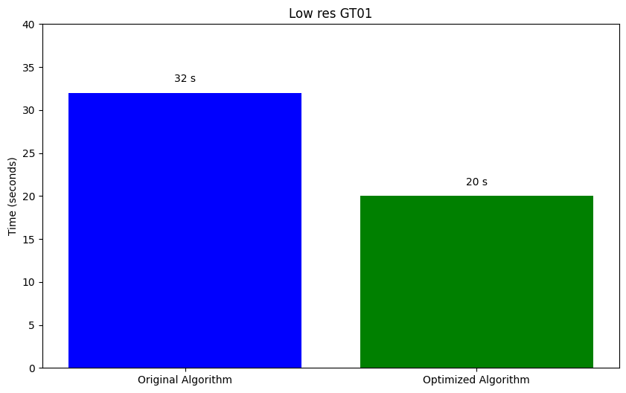
Optimization
Operations of For Loop > Matrix
For Loop > Matrix Operation
Process multiple pixels for foreground and background
&
update multiple alpha values

Slide 13
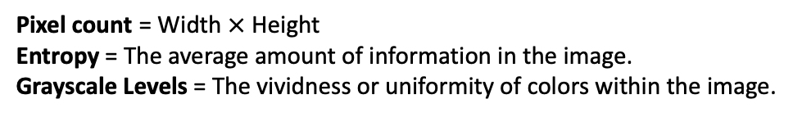
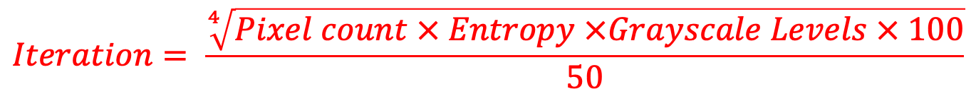
Optimization
Dynamic Iteration
Calculate image complexity through three indices
&
Establish the relationship between image complexity and iteration.
$$Iteration= \frac{\sqrt[4]{Pixel count × Entropy ×Grayscale Levels × 100}}{50}$$
Pixel count = Width $×$ Height
Entropy = The average amount of information in the image.
Grayscale Levels = The vividness or uniformity of colors within the image.

Slide 14


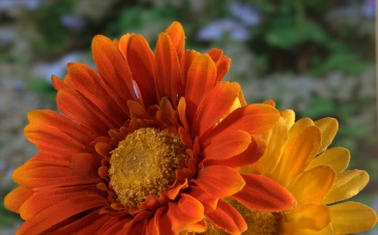
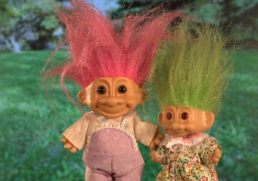

Optimization
Dynamic Iteration
Pixel count = 12,192,768
Entropy = 7.69
Grayscale Levels = 256
Iteration = 25
Pixel Count: 6193265
Entropy: 7.04
Grayscale Levels: 223
Iteration: 20
Pixel Count = 397600
Entropy = 7.03
Grayscale Levels = 217
Iteration = 10
Highres GT01
Lowres GT01
Pixel Count: 7576800
Entropy: 7.04
Grayscale Levels: 245
Iteration: 22
Pixel Count: 450400
Entropy: 7.01
Grayscale Levels: 238
Iteration: 11
Highres GT04
Lowres GT04

Slide 15
Implementation highlights.
The U-Net model is used for learning and inference, resulting in an image segmentation framework that separates objects from the background.
Filter out mismatched files
Resize and convert to tensor
Provide data to the model in batch
U-net Model
Data Preparation
Data Segmentation
Data Load
Model Preparation
Training and evaluation
Visualization
U-Net components
Loss Function
Activate Function
Optimiser
DoubleConv Down
Up
OutConv
Dice Loss
ReLU
Adam

Slide 16
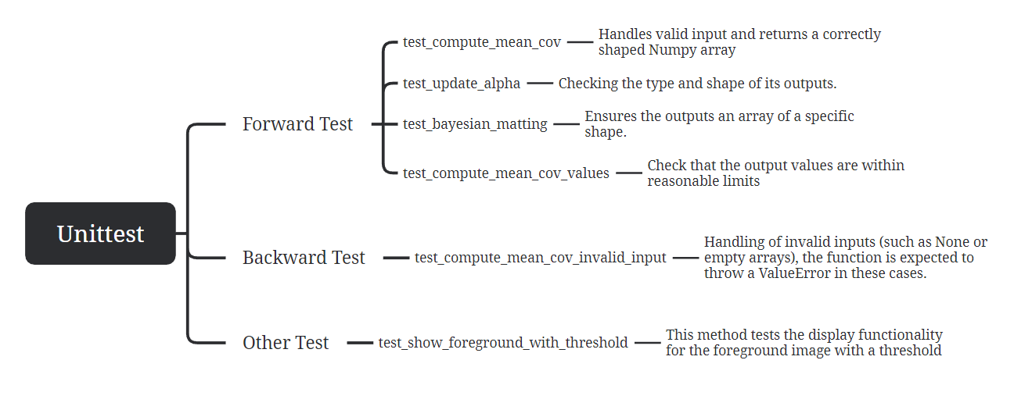

Slide 17
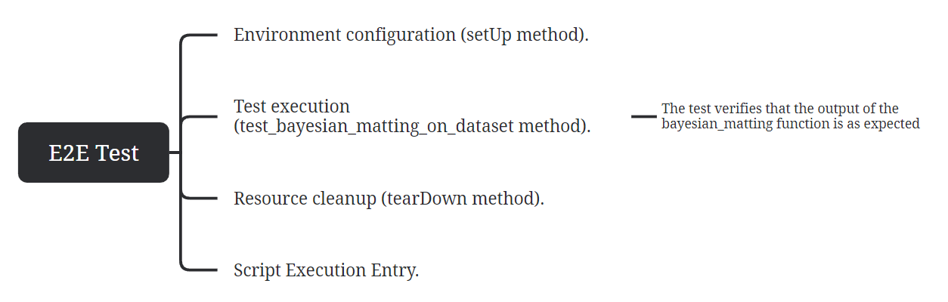
Notes:
08974035-693b-4550-9adc-9c3c17b653c6.source.default.zh-Hans

Slide 18
Thank You

